Slide 1
Lab 4: Variability Due to the Measuring Instrument
As you enter room:
* Find your name on the sign in sheet.
Sign In by your Name
Find the Table you were randomly assigned.
** Sit at any of the seats and the table you were assigned.
Graded Lab 1 Reports will be returned – keep these in case of an issue with the gradebook

Slide 2
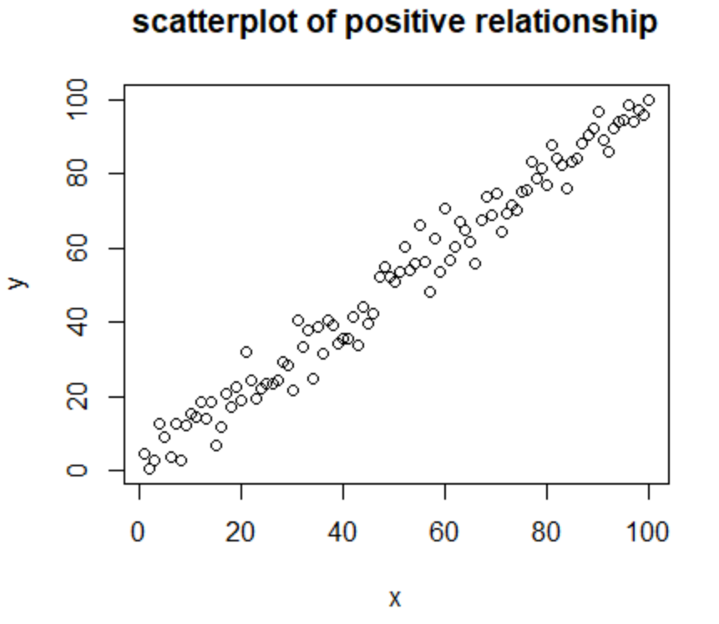
Concepts Needed for Lab 4
Relationships between two quantitative variables:
Determined by …
Looking at a scatterplot.
If as x increases, y tends to increase (the dots are rising as you read left to right) there is a positive relationship.
If as x increases, y tends to decrease (the dots are falling as you read left to right) there is a negative relationship.
Closer the dots fall to a given pattern, the stronger the relationship.
Calculating a correlation coefficient, r.
If r is negative then negative relationship.
If r is positive then positive relationship.
The closer the value is to -1 or +1 (range between -1 and 1) the stronger the linear (line) pattern.

Slide 3
Concepts Needed for Lab 4
Regression:
If two variables have a relatively strong relationship a statistical model can be created to predict new values of the response variable using the predictor variable.
In other words, we can determine the mathematical equation that shows the pattern in the data.
If the pattern is linear:
response variable = slope *(predictor variable) + y-intercept - OR- y = mx + b.
If the pattern is curved:
Response variable = y-intercept + coefficient1 * (predictor variable) + coefficient2* (predictor variable)^2.
(Note there are many ways to fit the curved data)

Slide 4
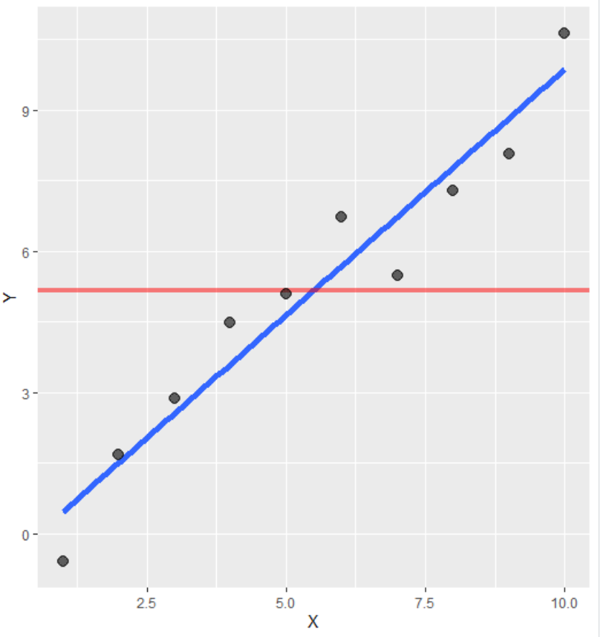
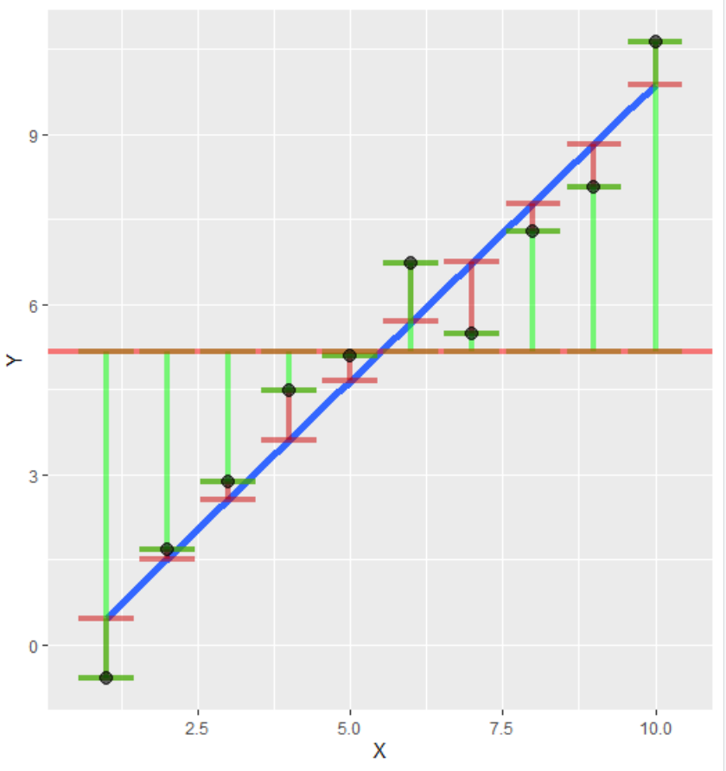
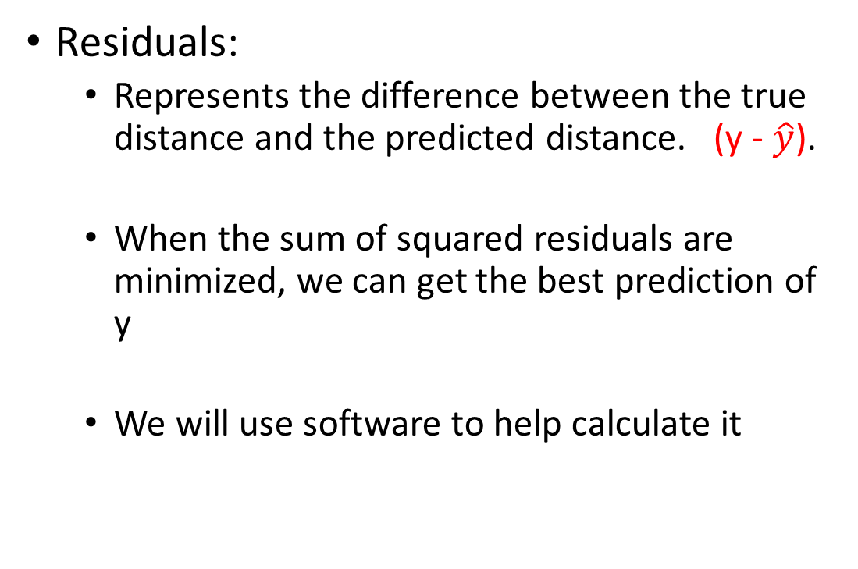

Concepts Needed for Lab 4
Residuals:
Represents the difference between the true distance and the predicted distance. (y - $\hat{y}$).
When the sum of squared residuals are minimized, we can get the best prediction of y
We will use software to help calculate it
Residual

Slide 5
For this Lab
Each table should have the following:
A list of a few objects all members at this table must find the true distance to(used as y) on the horseshoe. (students should use this to fill in some of the cells in column 5, Your Team’s Measured Distance (ft), on table 4.1 page 29.).
Group 1 and 2 measure object 1,2,3,4.
Group 3 and 4 measure object 5,6,7.
Group 5 and 6 measure object 8,9,10
A survey wheel.

Slide 6
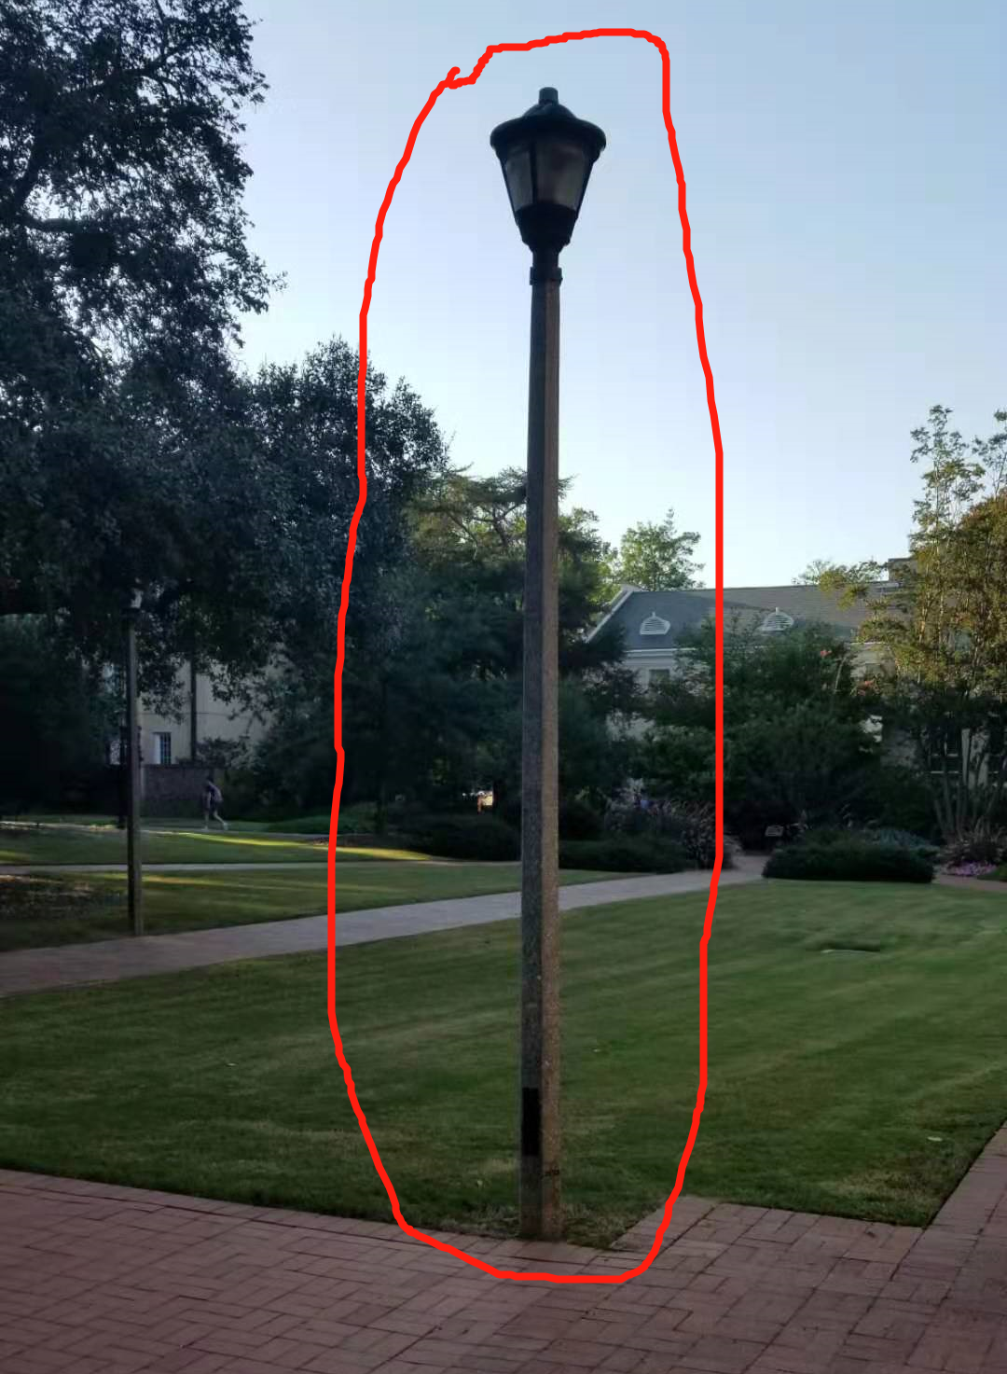
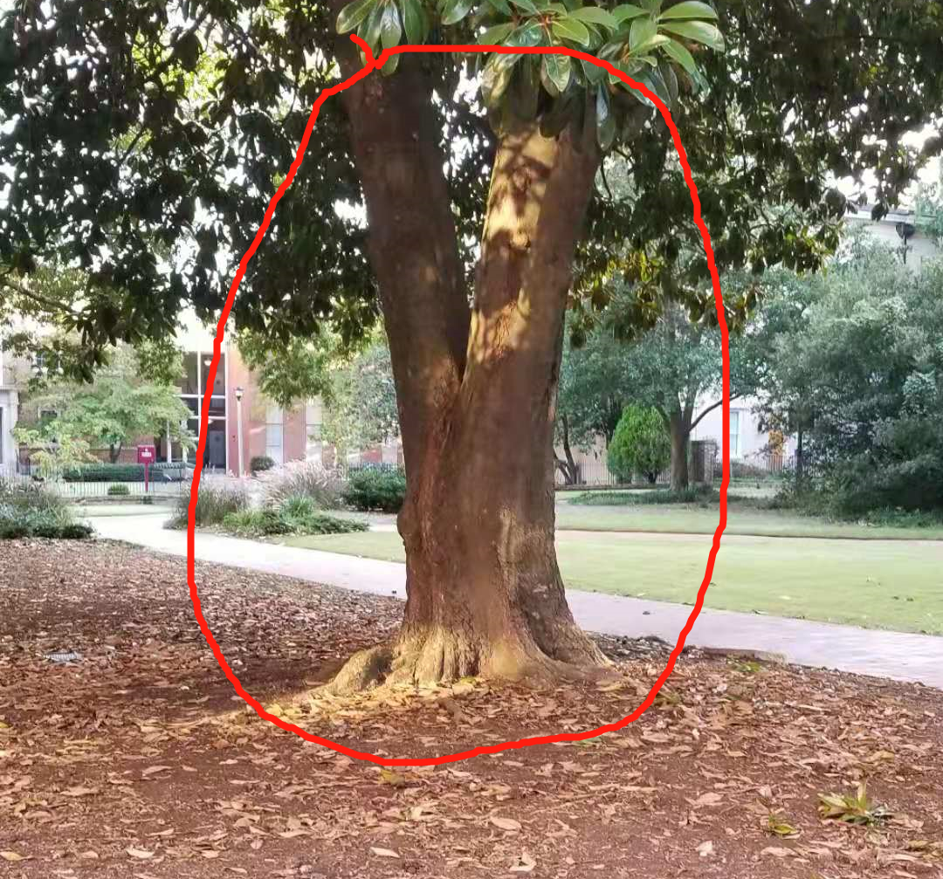
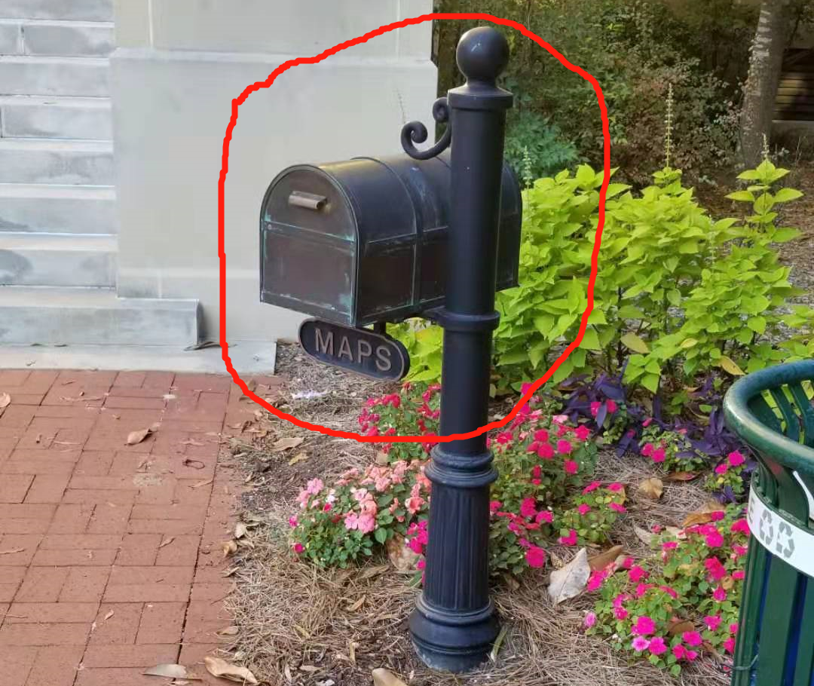
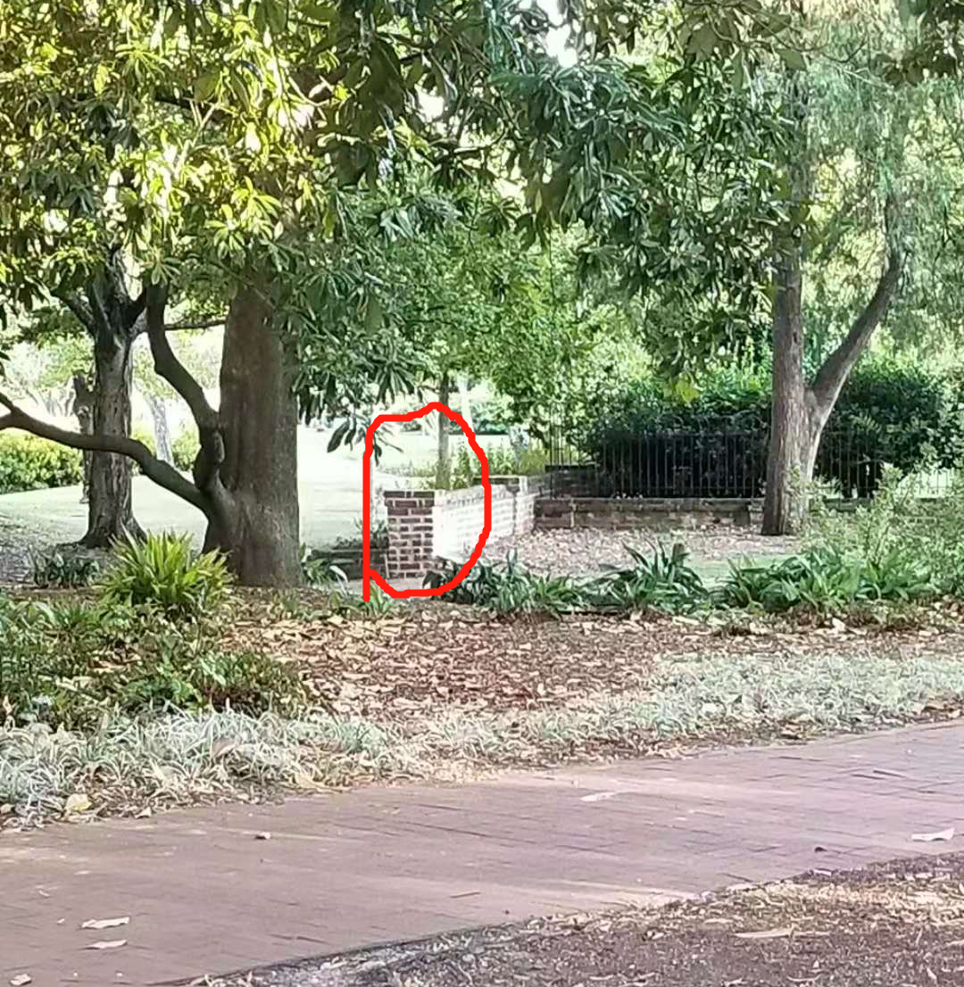
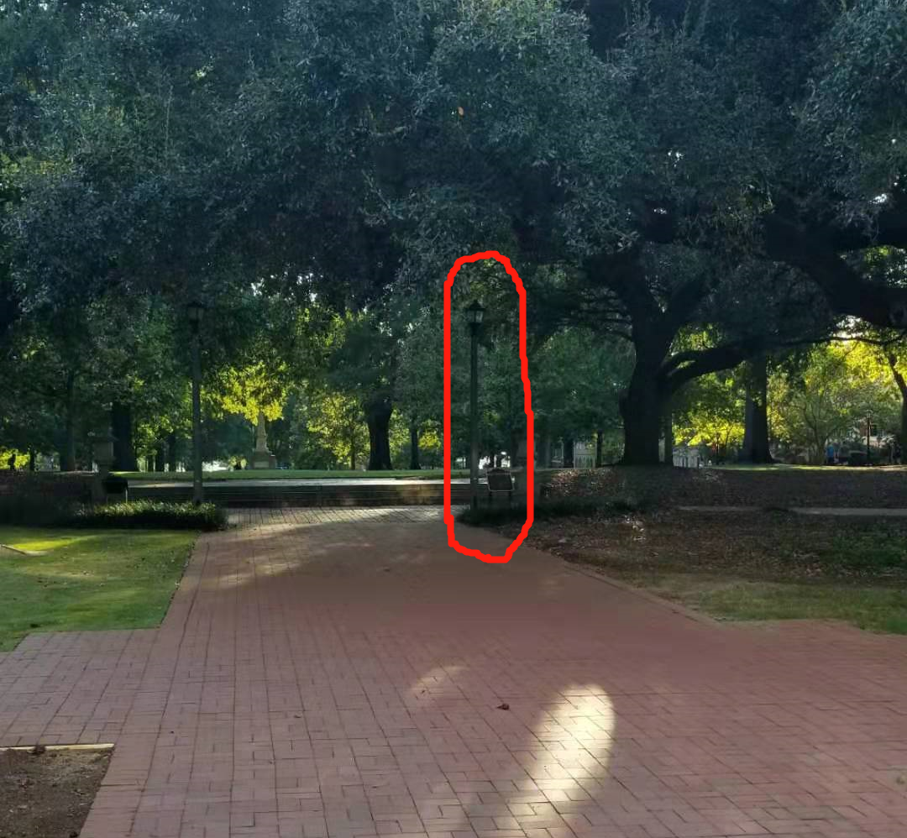
3
2
1 Distance to Maps Box
2 Base of Closest Magnolia Tree
3 Lamp Post across sidewalk
4 Lamp Post on Right at the end of sidewalk leading to horseshoe
5 Base of Brick Wall
1
4
5

Slide 7
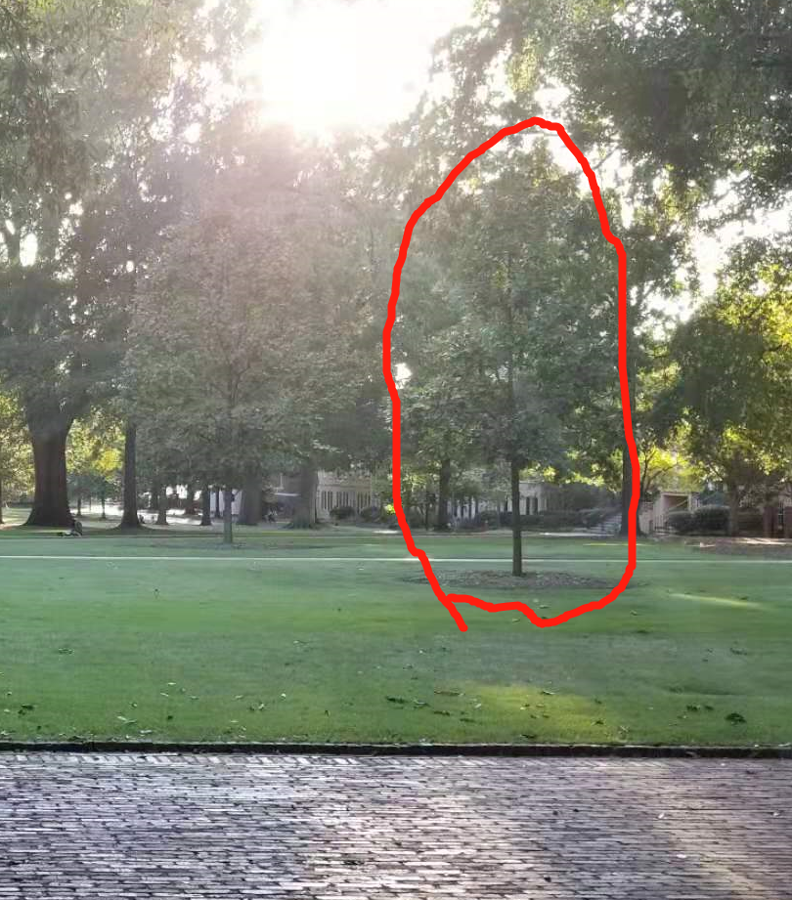
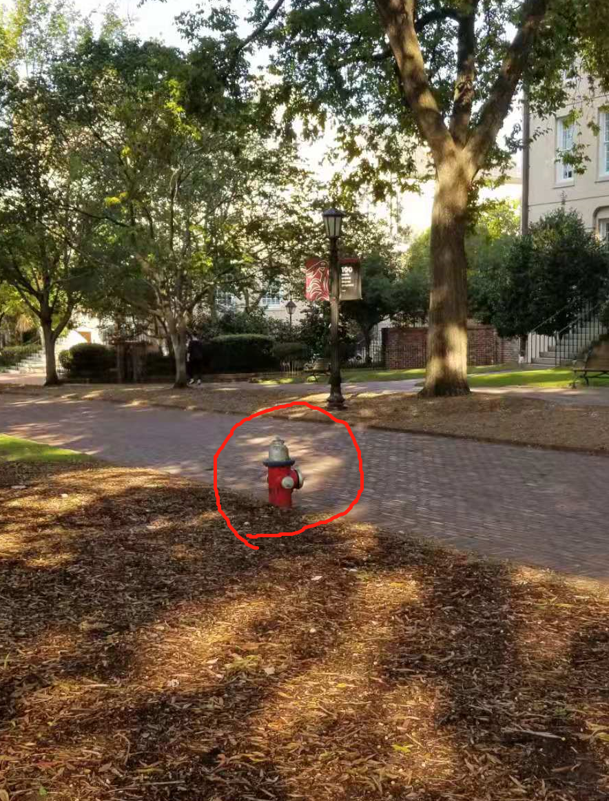
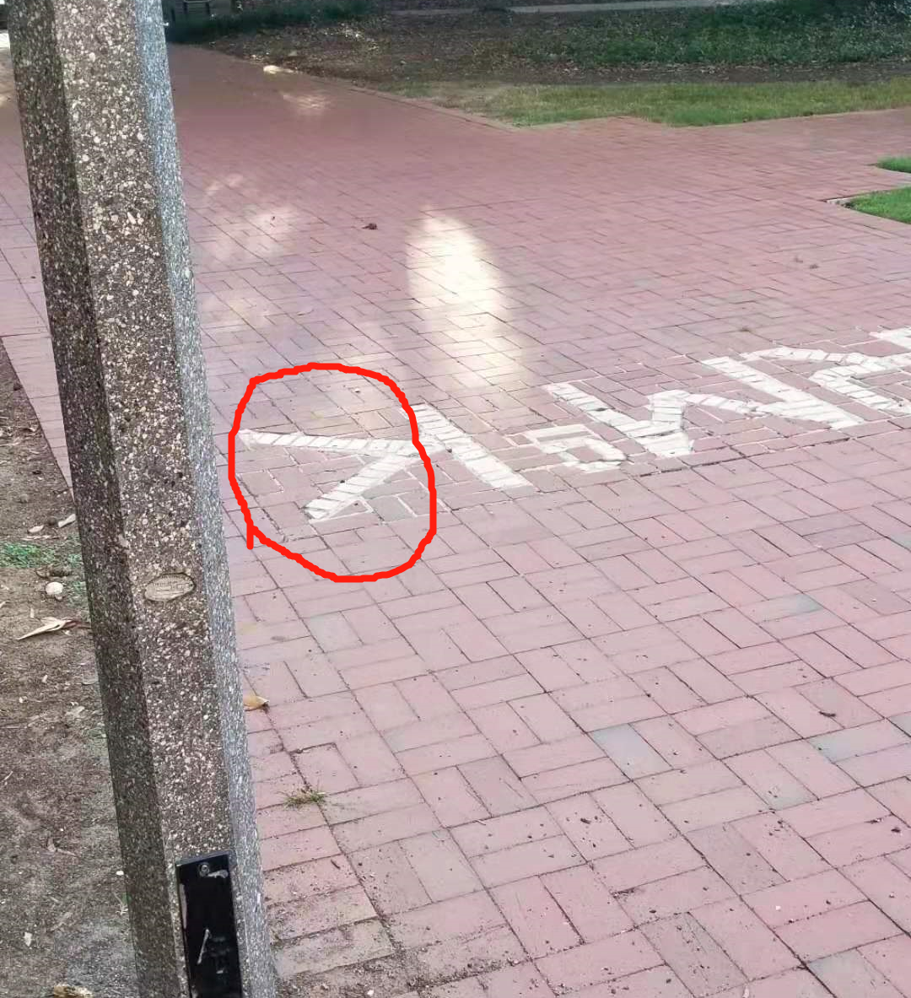
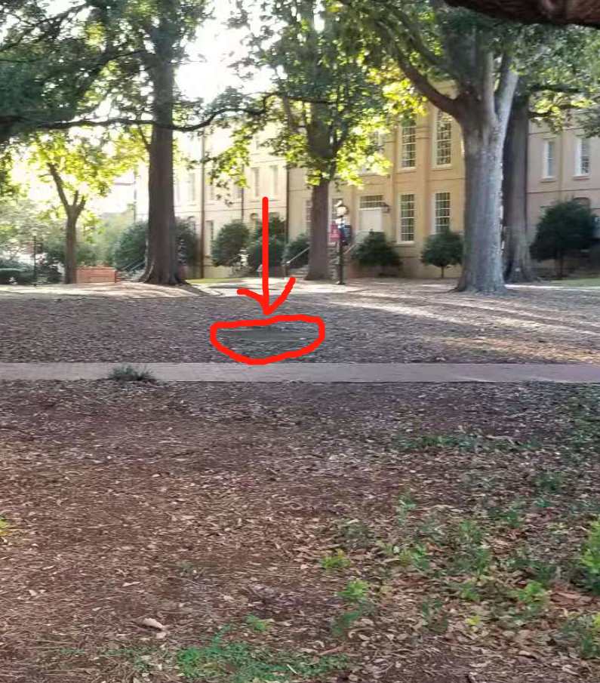
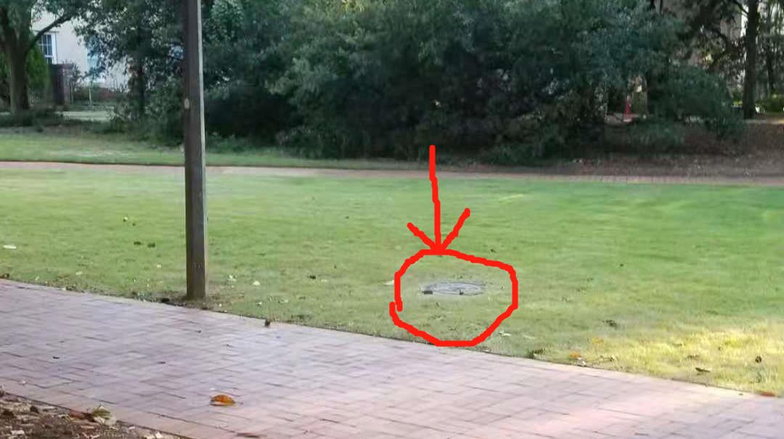
7
9
10
6
6 Red fire hydrant to right
7 Shortest distance to letters on Sidewalk
8 Nearest point to manhole cover to left.
9 Closest corner to concrete square to right.
10 Facing statue first tree past oval walkway.
8

Slide 8
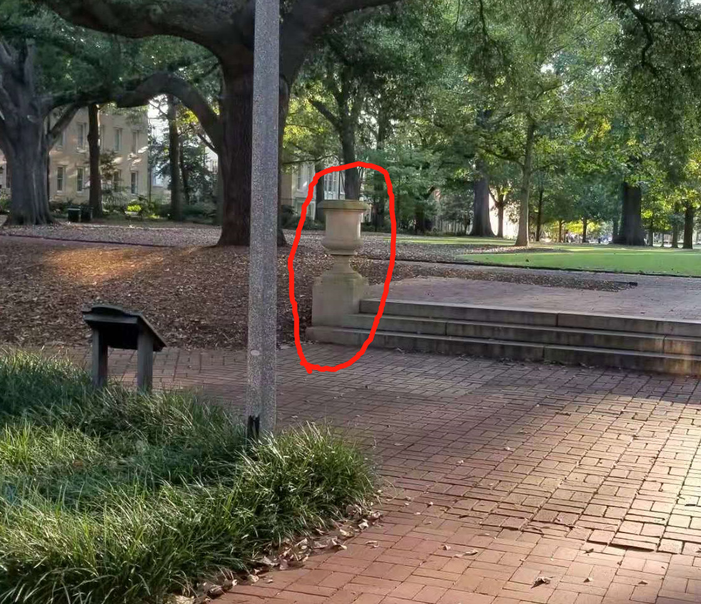
11 Left most urn
We will also guess the distance(used as x) from a reference point to 11 different landmarks. (each student have their own guess)
We do not measure the distance of the 11th object, we just guess it
We will use the 11th object to check your prediction and validate your model later.

Slide 9
Data Collection for Lab 4
Take all the following outside with you (everything else you can leave in the room the door will be closed and locked):
Your lab book (to fill in table 4.1 on page 29).
The survey wheel. (one per table).
Each student will collect their own data. Everyone must take their lab books outside and everyone must write down a guess to each landmark. Don’t leave the horseshoe without having column 3, Guessed Distance (ft), completely filled in on page 29.
Each lab table was assigned a few landmarks to measure the distance to. After all guesses are done (the lab instructors will lead this), each labs will measure the distance from the reference point to the assigned landmark, these are written in the 5thcolumn of table 4.1.

Slide 10
Data Collection for Lab 4
The following are done after everyone is back in the lab room：
Provide the lab instructor with your lab group’s distances measured.
We will use the median of the 3 different measured distances.
Fill in the 6th column, True Distance (Median Measured Distance (ft)), in Table 4.1 on page 29. Everyone will have the same values here.
Think about why we might want to use the median as the true distance (See question #1 on page 30).
At this point everyone should have their Guessed Distances (these will be our predictor variable, x) and the True Distances (these will be our response variables, y).

Slide 11
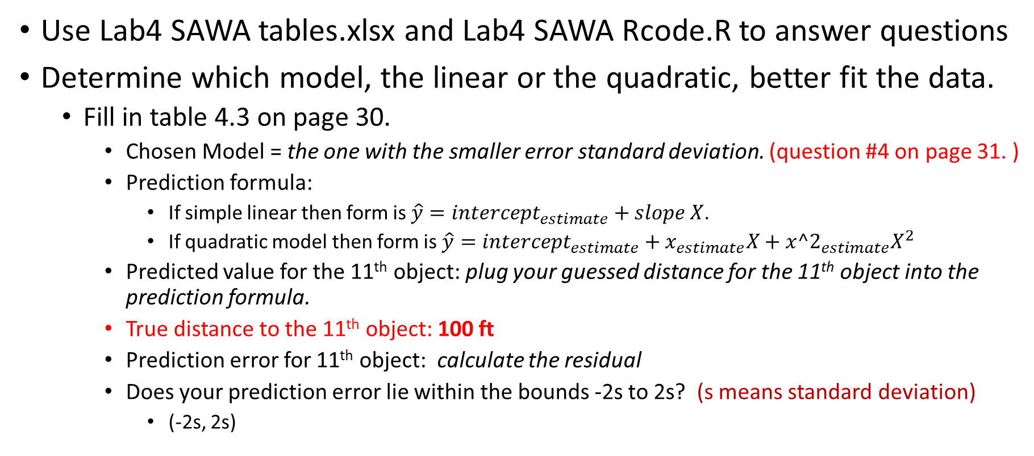
Data Analysis for Lab 4
Use Lab4 SAWA tables.xlsx and Lab4 SAWA Rcode.R to answer questions
Determine which model, the linear or the quadratic, better fit the data.
Fill in table 4.3 on page 30.
Chosen Model = the one with the smaller error standard deviation. (question #4 on page 31. )
Prediction formula:
If simple linear then form is $\hat{y}=intercept_{estimate}+slope X$.
If quadratic model then form is $\hat{y}=intercept_{estimate}+x_{estimate}X+x{^2}_{estimate}X^{2}$
Predicted value for the 11th object: plug your guessed distance for the 11th object into the prediction formula.
True distance to the 11th object: 100 ft
Prediction error for 11th object: calculate the residual
Does your prediction error lie within the bounds -2s to 2s? (s means standard deviation)
(-2s, 2s)

Slide 12
Before you Leave
Turn in pages 29-31 from the lab book. Everyone needs to turn in their own work.
Make sure columns 3 and 6 are filled in on table 4.1 page 29.
Make sure all parts of tables 4.2 and 4.3 are completely filled in on page 30.
Make sure you answer all questions completely.
Help with #5
Reality Check question is in reference to the Reality Check box on page 28.

